Slide 1
Value Measure

Slide 2
Data collection
25 team
8 bootstrap
7 mature
10 scale
Data (Git history , code), ~120 GB
~400 developers

Slide 3
Measurements
Measure | What it is | How It is measure | Expected Values
Development Hours per Day | A Heuristic measurement Indicating no of Hours Spent during durations Per Day. Unit is No Of Hours. Higher the better. | We identify coding sessions (continuous hours of coding) and start time to end time we calculate as Development Hours. For first commit of Session we give extra values. | <1 Bad 1-2 ok 2-3 good >3 excellent
Coding Volume per Day | A statistical measurement about no of lines of code committed Per Day. Higher the better. | Source is git /svn which provided details like no of lines added/deleted/Modified in each commit. | Bootstrap (<100 bad ,100-200 good, >200 excellent ),Scale(<50 bad , 50-100 good , >100 excellent)Mature(<10 bad , 10-50 good, >50 excellent)
Quality Score | An aggregated value (avg) of all 5 point quality (Maintainability, security, reliability, complexity, cognitive complexity) measurements, lesser the better. | Sonar Generated 5 point quality for all code commits. We know the commit author and take industry standard average. | <=1 Excellent , 1-2 good/ok, 2-3 bad , >3 very bad
Design Score (High I2 and above) | An aggregated value (avg) of all 3 point Design (Coupling, Stability, Churn) measurements, lesser the better. | Our Code Generated 3 point Designs for all code commits. We know the commit author and take standard average. | <=1 Excellent , 1-2 good/ok, 2-3 bad , >3 very bad
Ownership Score (I3 and above) | A statistical measurement about no of components owned by an individual. | For Each component in source code, we Identify The Ownership of authors using tree visiting on source code. | >5 Excellent , 3-5 good , 2-3 ok ,<2 Bad
Leadership Score (I3 and above) | An aggregated value (Sum) of all 3 point Design (Initiative, sharing, Strength) measurements, Higher the better. | Our Code Generated 3 point Leadership for all code commits. We know the commit author and take summation. | >5 Excellent , 3-5 good , 2-3 ok ,<2 Bad

Slide 4
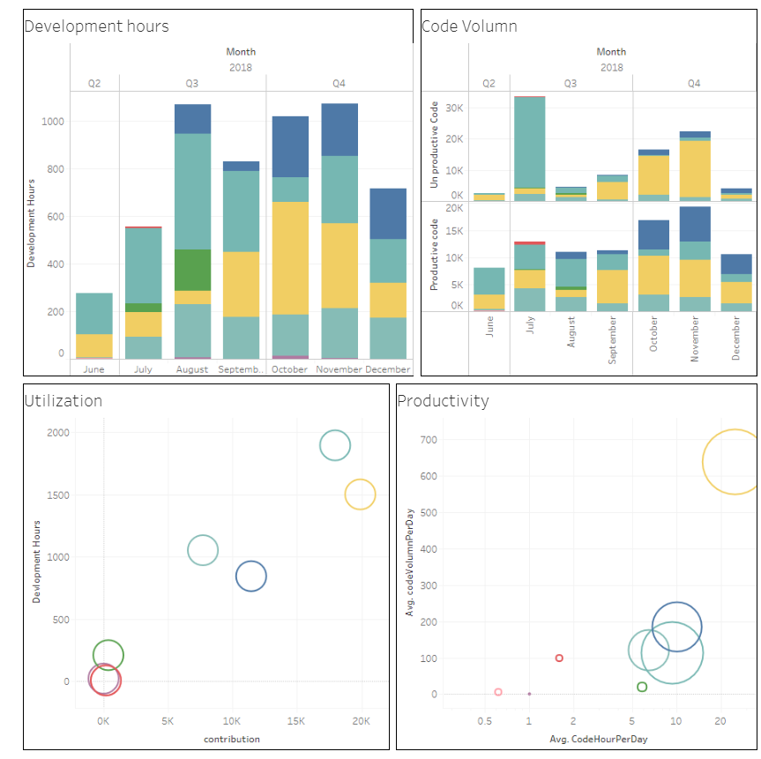
Sample bootstrap

Slide 5
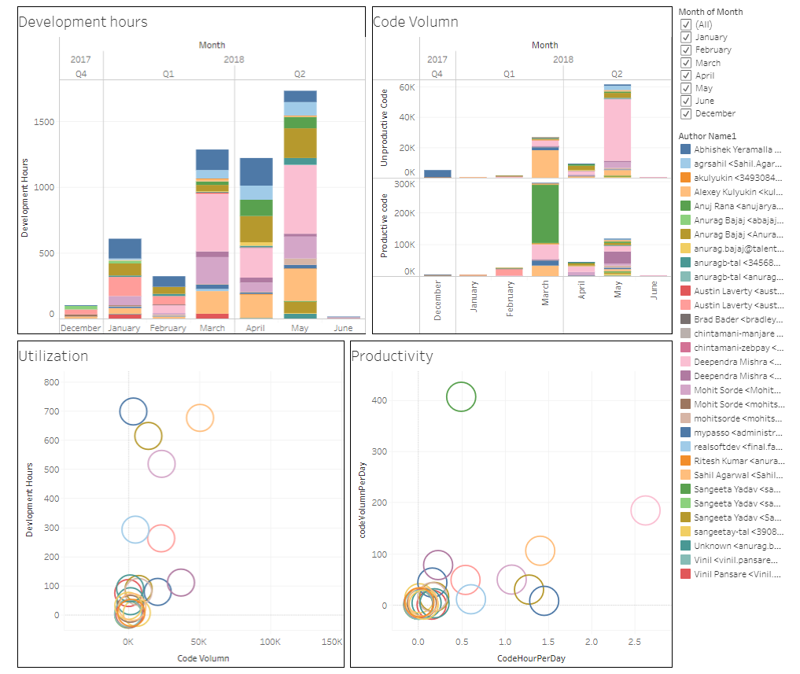
Sample Scale

Slide 6
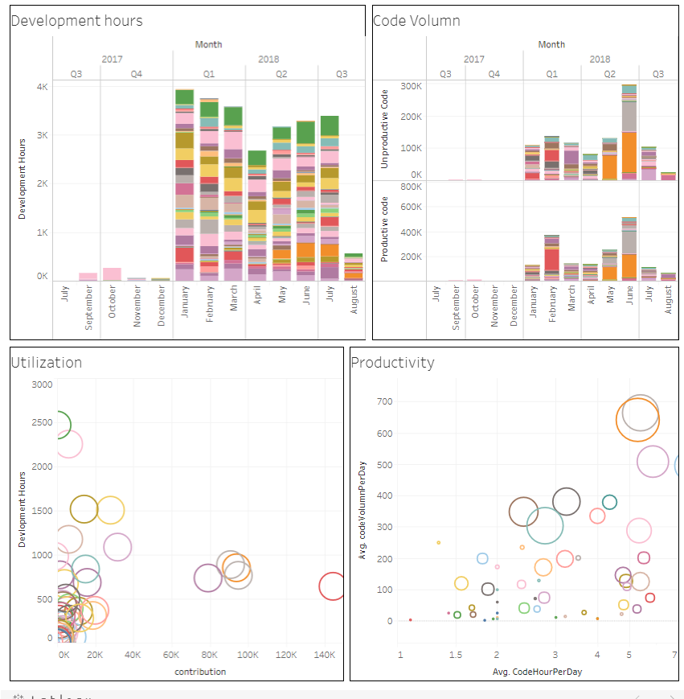
Sample Mature

Slide 7
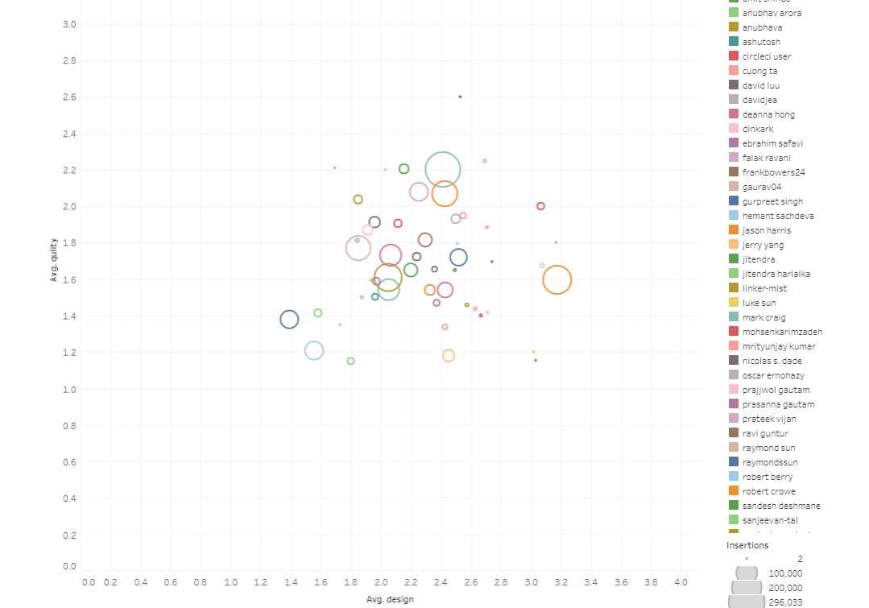
Sample Quality& Design

Slide 8
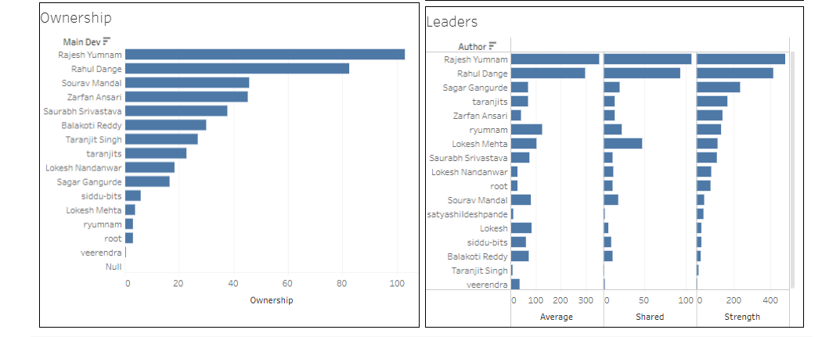
Ownership and Leaders

Slide 9
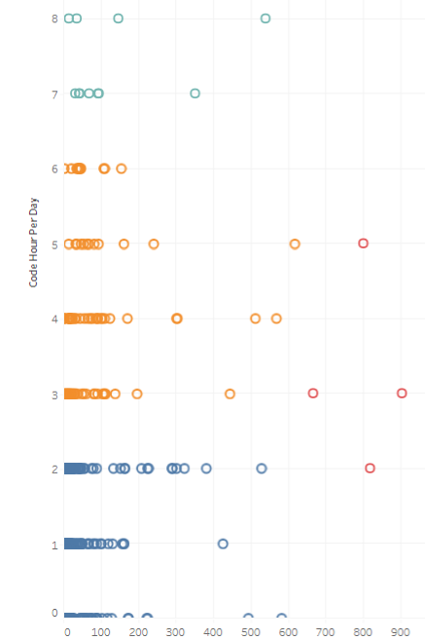


Productivity Company Wide

Slide 10
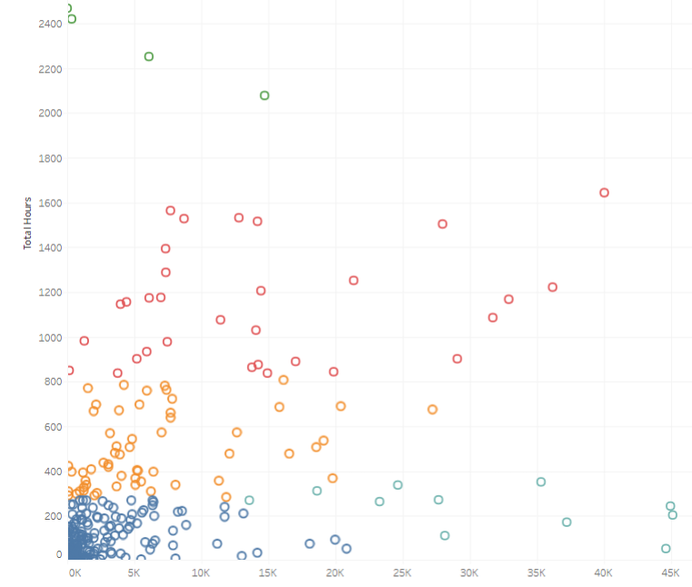

Utilization Company Wide

Slide 11
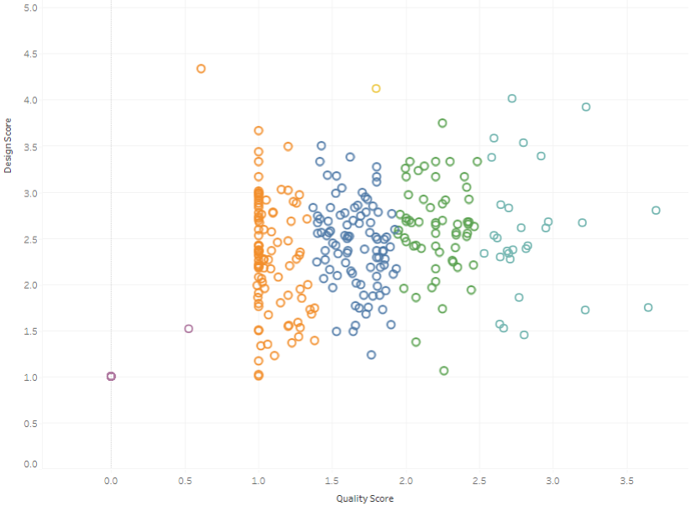
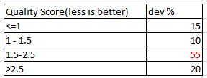
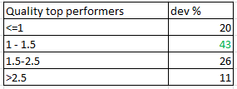
Quality Company wide

Slide 12
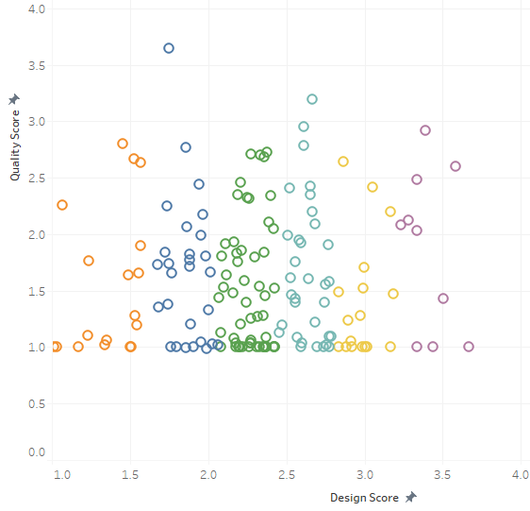
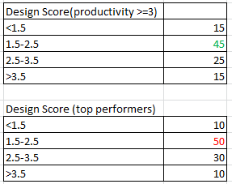
Design company wide

Slide 13

Ownership and Leaders

